Slide 1
Top 5 Ways to Improve your Apple End User Experience in AAD/M365

Slide 2


Intro
Michael Epping
Product Manager, Microsoft
michael.epping@microsoft.com
@_michaelepping
Mark Morowczynski
Product Manager, Microsoft
markmoro@microsoft.com
@markmorow

Slide 3
Agenda
What is Azure AD and Conditional Access?
Prompting…why is it bad?
Top 5 Recommendations
Go-Dos

Slide 4
What is Azure AD and Conditional Access?

Slide 5
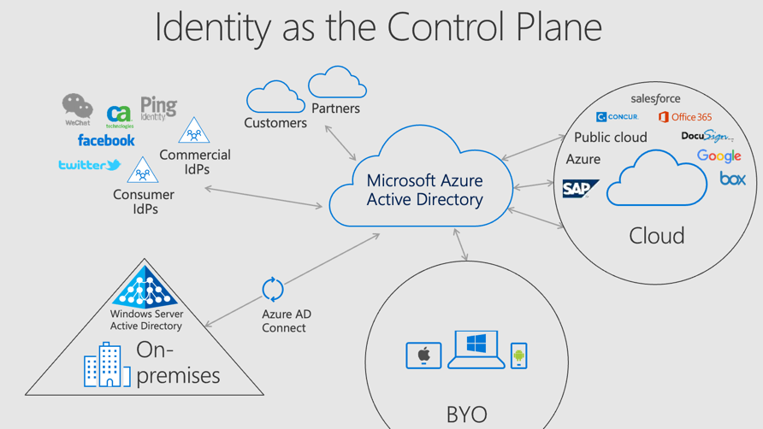
Azure AD
Azure AD is a full blown IDaaS solution, not an IDP for just Office 365/Azure
Resources are moving to the cloud, devices are proliferating, users are outside the office
Identity needs to be the new control plane, rather than the network perimeter

Slide 6
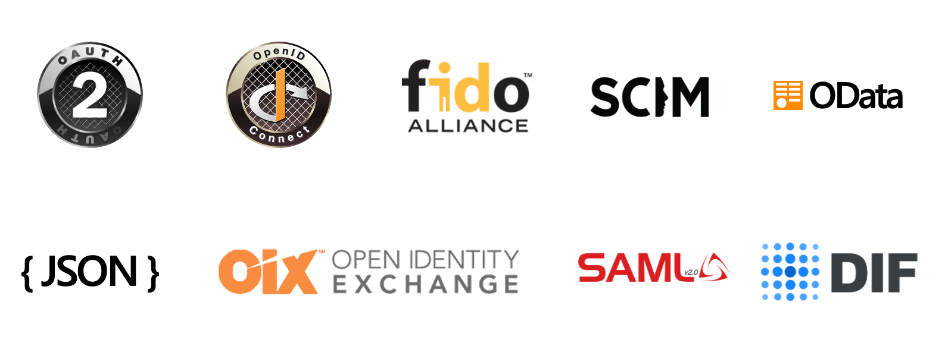
Azure AD Protocols
Committed to open standards, especially OpenID Connect and other modern protocols
Microsoft cloud services are built on OpenID Connect
Investing in new standards, like FIDO and DIF
See joint Passkeys announcement from FIDO foundation, Microsoft, Apple, and Google: https://aka.ms/PasskeyAnnouncement

Slide 7
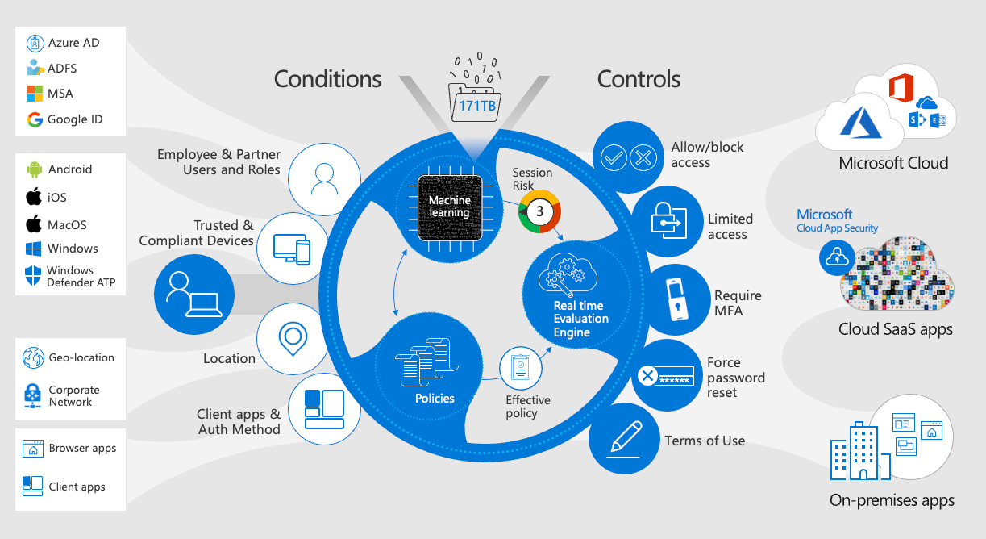
Conditional Access
Zero-trust AuthN and AuthZ engine
Evaluate trust every time a user or device requests access to a resource
Conditional access understands the user’s activity
User location
User Risk
State of device
App requirements

Slide 8
Conditional Access Evaluation Phase
{
"userDisplayName": "Michael Epping",
"appDisplayName": "Azure Portal",
"ipAddress": "97.113.39.216",
"clientAppUsed": "Browser",
"conditionalAccessStatus": "success",
"riskDetail": "none",
"riskLevelAggregated": "none",
"riskLevelDuringSignIn": "none",
"riskState": "none",
"resourceDisplayName": "Windows Azure Service Management API",
"deviceDetail": {
"deviceId": "",
"displayName": "",
"operatingSystem": "MacOs",
"browser": "Edge 102.0.1245",
"isCompliant": false,
"isManaged": false,
"trustType": ""
},
"location": {
"city": "Seattle",
"state": "Washington",
"countryOrRegion": "US",
"geoCoordinates": {
"altitude": null,
"latitude": 47.61837,
"longitude": -122.3142
}
}
}
All Conditional Access polices are ANDed together. (Not like GPO LSDO precedence)
Is Policy in scope of the request
BLOCK controls satisfied first
GRANT controls applied in order
Risk
MFA
Device
Approved client app/app protection
Tries to satisfy policy without user interaction
Example: Control MFA or Device compliant. If device is NOT compliant, will THEN prompt for MFA.

Slide 9
Conditional Access Evaluation Phase
{
"userDisplayName": "Michael Epping",
"appDisplayName": "Azure Portal",
"ipAddress": "97.113.39.216",
"clientAppUsed": "Browser",
"conditionalAccessStatus": "success",
"riskDetail": "none",
"riskLevelAggregated": "none",
"riskLevelDuringSignIn": "none",
"riskState": "none",
"resourceDisplayName": "Windows Azure Service Management API",
"deviceDetail": {
"deviceId": "",
"displayName": "",
"operatingSystem": "MacOs",
"browser": "Edge 102.0.1245",
"isCompliant": false,
"isManaged": false,
"trustType": ""
},
"location": {
"city": "Seattle",
"state": "Washington",
"countryOrRegion": "US",
"geoCoordinates": {
"altitude": null,
"latitude": 47.61837,
"longitude": -122.3142
}
}
}
Conditional Access collects this type of data on every auth attempt
Interactive AND non-interactive
Common Policies might take one of these actions for this type of sign-in:
Block access since device is not compliant
Grant access, but set a Sign-In Frequency to 2 hours

Slide 10
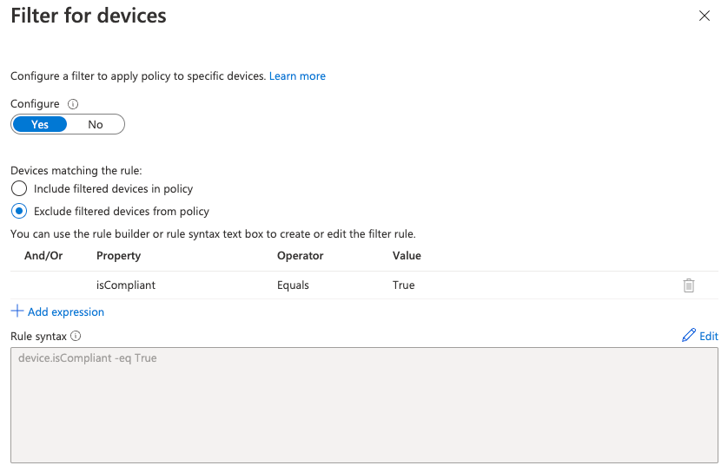
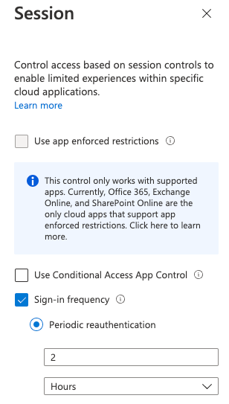
Common Policies
Talk to your IAM team to understand your Conditional Access policies
Requiring MFA for all users
Blocking legacy auth
Blocking access by country location
Require compliant or hybrid join device
Stricter Controls for non-corp managed devices (is this macOS in your environment?)
Sign-In Frequency to 2 hours for everything not filtered out
"Good" for security, but…

Slide 11
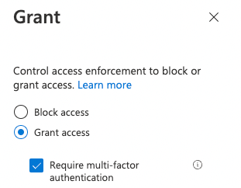
Sample Policy
Policy applies to the user and the app
Filter out compliant devices
Require MFA for everything not filtered out
Set Sign-In Frequency to 2 hours for everything not filtered out
"Good" for security, but…

Slide 12
Agenda
What is Azure AD and Conditional Access?
Prompting…why is it bad?
Top 5 Recommendations
Go-Dos

Slide 13
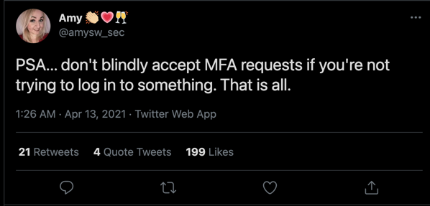
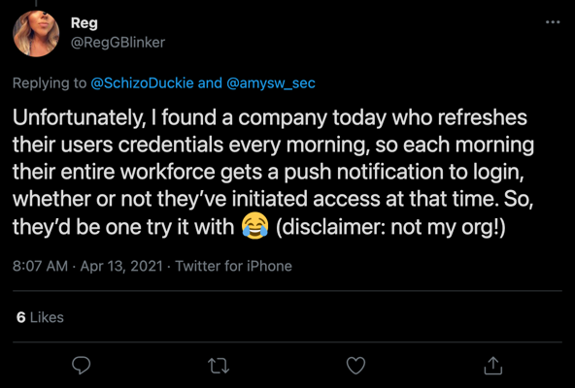
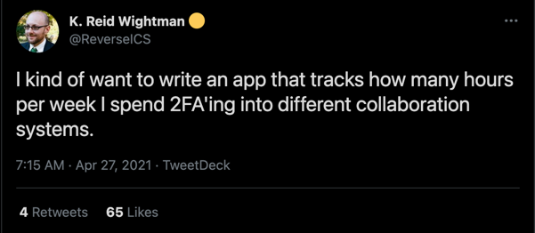

Slide 14
Customer Case Study
European financial company simulated cyber attack.
Attackers used password spray to find users with weak passwords.
Users with compromised passwords were “hammered” with MFA prompts.
Findings:
No reports of unexpected prompts to the help desk.
Many users blindly approved MFA requests.
One user had uninstalled the Authenticator app.

Slide 15
Why Prompting is Bad
Over-prompting leads to compromise
Users learn bad behaviors, like blindly approving MFA requests
Prompts impact productivity, especially on platforms without SSO
Prompting is especially common on macOS, which does not do SSO with Azure AD out of the box
Should strive to improve user experience AND security
Prompt when needed, such as new device, new location, change in risk, etc.
Passwordless makes prompting less impactful when it IS needed

Slide 16
Prompts are bad

Slide 17
Agenda
What is Azure AD and Conditional Access?
Prompting…why is it bad?
Top 5 Recommendations
Go-Dos

Slide 18
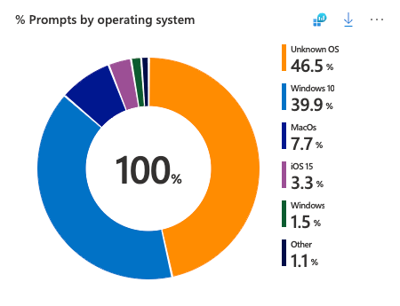
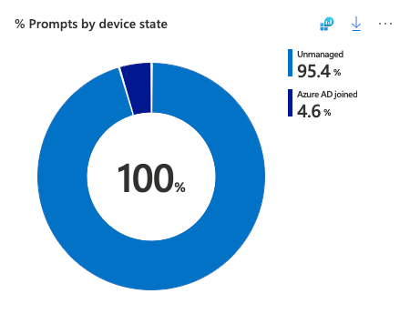
Recommendation 1: Determine if you have a prompting problem
Show it with data!
All the data you need is in your Azure AD sign-in logs
Use the pre-built Azure AD Workbook http://aka.ms/MFAPromptsWorkbook
Comes with data visualizations as well as recommendations:
Which users are being prompted the most?
Which applications have a high prompt count?
What is the device state?

Slide 19
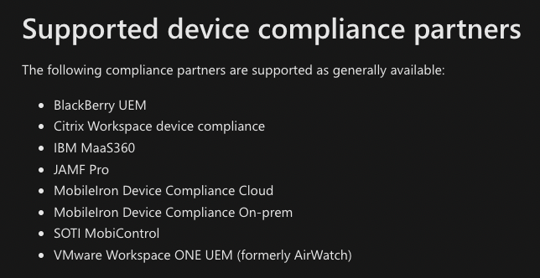
Recommendation 2: Enroll in MDM, Use Device Compliance
MDM is the only modern way to deploy SSO features to macOS
MDM helps us improve device and identity security (Conditional Access)
SSO helps us improve end-user experience (fewer prompts) and security (over-prompting trains users to make poor decisions)
These are related, but different features
Intune or Intune-integrated MDMs can send compliance information to Azure AD
This information is critical for those device-based Conditional Access policies
Without Intune or an Intune-integrated MDM, Azure AD sees all Macs as unmanaged

Slide 20
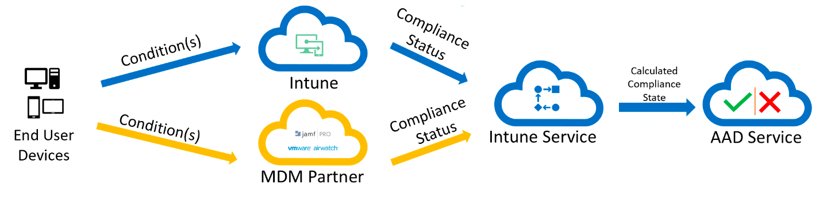
Recommendation 2: Enroll in MDM, Use Device Compliance
Good macOS security with Azure AD requires two MDM-delivered capabilities:
Device health attestation
SSO deployed through the MDM channel…reduce prompts as much as possible
Device health and compliance integration with Azure AD is easy to deploy if Intune is the MDM
Jamf Pro and other 3rd Party MDMs can integrate with Intune to support device compliance
Extra work, but worth it

Slide 21
Recommendation 3: Set up SSO Infrastructure
macOS can provide SSO in a few different ways:
Kerberos, via BIND to an LDAP directory, commonly on-premises Active Directory
Apple is actively telling customers to move away from this
Kerberos, via Apple’s Kerberos SSO Extension
Must be deployed through MDM
Still designed for on-premises directory services, not really designed for the cloud
Modern Auth (tokens), via IDP vendor-provided plug-ins for Apple’s Extensible Enterprise SSO Framework
IDP vendor…that’s us!
Must be deployed through MDM
Two types:
Credential
Redirect – Azure AD’s option is this type

Slide 22



Recommendation 3: SSO Infrastructure - Let’s Start with Kerberos
If you need Kerberos, use the modern, MDM-provisioned Kerberos SSO Extension from Apple:
User provides device with their enterprise username and password
The device sends the creds to AD and asks for a Kerberos Ticket-Granting Ticket (TGT)
AD validates the creds and returns the TGT
The user tries to access an app, probably in their browser, but needs a Kerberos ticket
Kerberos
App
U: jane.doe@contoso.com
P: Summer2022!
Active Directory

Slide 23


Recommendation 3: SSO Infrastructure - Let’s Start with Kerberos
macOS sends the TGT to AD, asking for a ticket specific to the app (TGS)
AD validates the TGT and returns the TGS
The user’s browser or other client sends the TGS to the app
The user successfully accesses the app
Kerberos
App
Active Directory

Slide 24
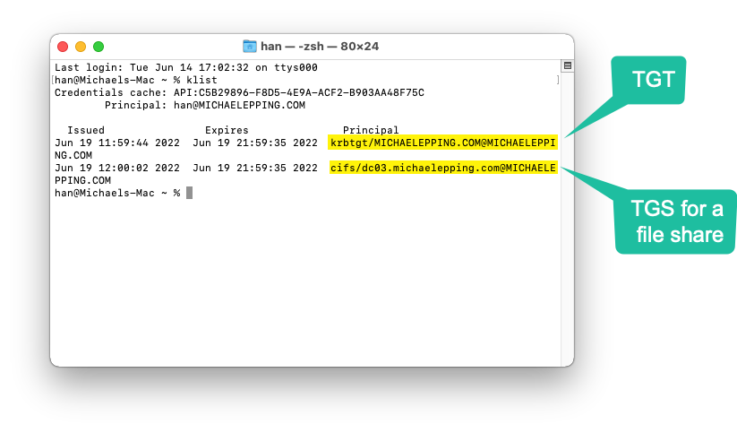
Recommendation 3: SSO Infrastructure - Let’s Start with Kerberos

Slide 25

Recommendation 3: SSO - Let’s Start with Kerberos
What’s the issues with this story?
It doesn’t work over the internet, so it isn’t very modern
Imagine we have a SaaS app instead of an internal Kerberos app
Kerberos doesn’t make sense for the SaaS app, because devices on the internet shouldn’t be able to find a DC
User provides device with their enterprise username and password
Should the device still want to send the creds to AD and ask for a Kerberos Ticket-Granting Ticket (TGT)?
No, this won’t work without a VPN
Kerberos
App
U: jane.doe@contoso.com
P: Summer2022!
SaaS
App
Active Directory

Slide 26
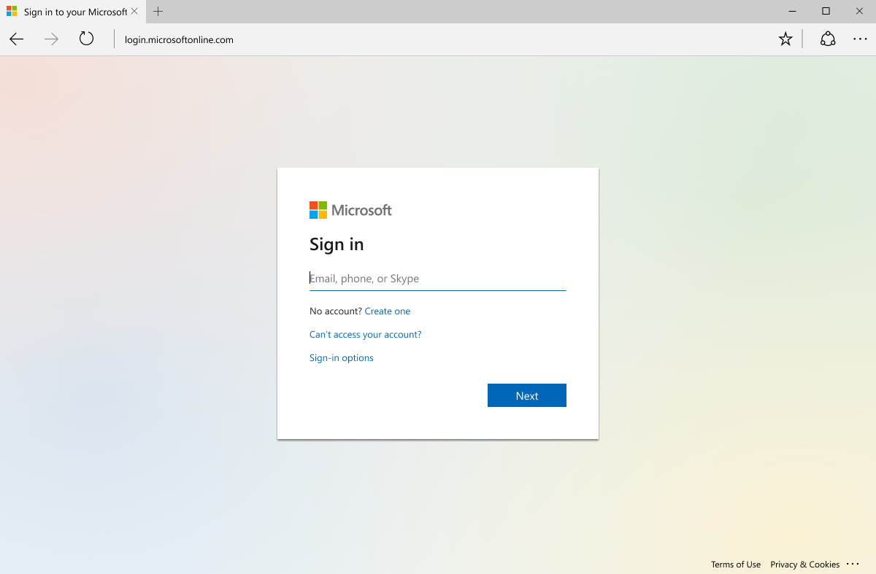
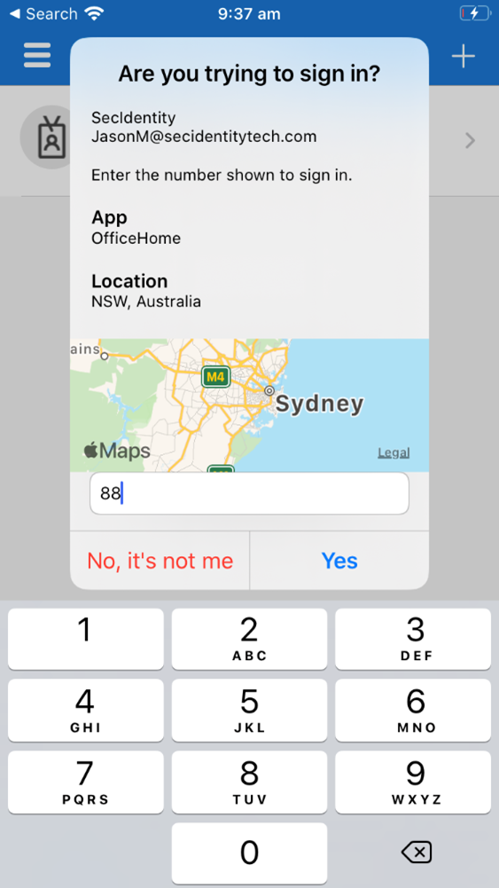
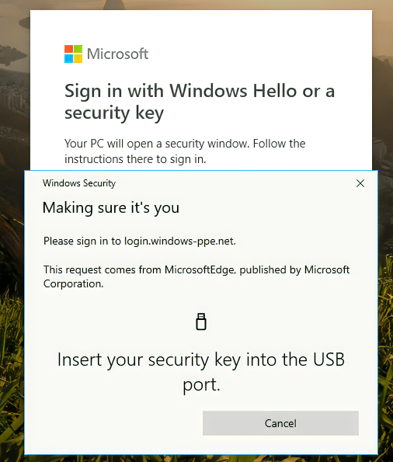
Recommendation 3: SSO – Modernize w/ Modern Auth
The solution is Modern Auth!
SAML – good
OpenID Connect and OAuth 2 - better!
The key advantage of Modern Auth is that it is web-based
The flexibility of web technology gives us many security options:
Challenge for certificates
Many forms of MFA (FIDO, Auth apps, Smartcards, SMS codes, etc.)
Direct traffic through proxied sessions to block downloads
And much more!

Slide 27

Recommendation 3: SSO – Modernize w/ Modern Auth
Per User/Device
Per Application
Our Goal: Prompt Once
per user
per device
per password change
Don’t bother user unless these change
Browser apps
Client apps
Web/App
Authentication
(Coarse) Authorization
Until Revoked or Password Change (If actively used within 14 days)
Until revoked or Password Changed
Refresh Token – (Per App)
Long term access to an application
Note: Includes whether MFA was used for authentication
Primary Refresh Token
Long term authentication w/ SSO broker on Windows, macOS, or iOS
ID Token
Long term authentication on Mobile Device (used by authenticator app and/or company portal) Note: Authenticator App has two functions: brokering authentication locally + MFA validation
1 hours
Access Token – (Per App)
Provides user access to use application (short term) Note: Policy is re-evaluated every time you get a new access token (using the refresh token)

Slide 28
Recommendation 3: SSO – Modernize w/ Modern Auth
Here’s what you need for Modern Auth and SSO on Apple Platforms:
IDP that supports SAML and/or OpenID Connect
Azure AD is Microsoft’s cloud IDP, but there are plenty of others on the market
Apps integrated with the IDP
IDP Vendor must create an SSO Extension plugin
Macs under MDM management

Slide 29





Recommendation 3: SSO – Modernize w/ IDP Vendor SSO Extensions
App
The modern approach is to use an IDP, modern auth, and tokens
SSO Extension is bundled in the Microsoft Company Portal
User authenticates to Azure AD in the SSO Extension window – this can be in Company Portal or another app, such as Safari
Azure AD supports many more credential types than AD does
Azure AD SSO Extension acquires a Primary Refresh Token (PRT) from Azure AD after the user signs in, stores it in the keychain
PRTs are good for a rolling 14 day window, constantly refreshed when the user uses the Mac
MS Authenticator Passwordless
Phone Sign-In
Username+Pwd+MFA (App, OTP, SMS, Phone)
Azure AD

Slide 30


Recommendation 3: SSO – Modernize w/ IDP Vendor SSO Extensions
App
One more wrinkle…there’s two different flows for apps to get tokens
We’ll start with the MSAL flow (MSAL is Microsoft Authentication Library, our auth library provided to make app integration with Azure AD easy):
App that uses MSAL talks to the SSO Extension directly, asks it to get a token
AAD validates the PRT and returns the app-specific token
The token is given to the client and the client sends the token to the app
The user successfully accesses the app
Azure AD

Slide 31
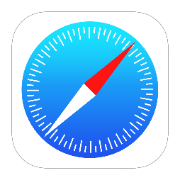
Recommendation 3: SSO – Modernize w/ IDP Vendor SSO Extensions
App
Now let’s look at the redirect flow:
User tries to log into app, is told to get a token from Azure AD
App that doesn’t use MSAL tries to go to an Azure AD URL…the macOS Network Stack intercepts the traffic and redirects it to the SSO Extension
SSO Extension uses its PRT to request a token
AAD validates the PRT and returns the app-specific token
The token is given to the client and the client sends the token to the app
The user successfully accesses the app
macOS Network Stack
Azure AD

Slide 32
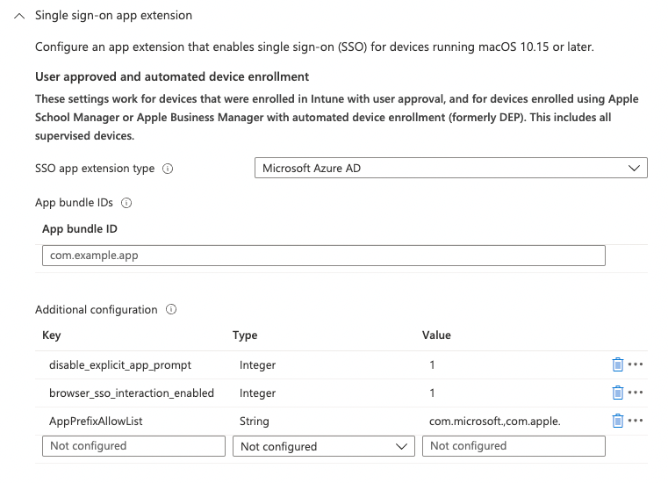
Recommendation 3: SSO – Modernize w/ IDP Vendor SSO Extensions
Redirect SSO Extension Profiles must be deployed via MDM:
Very easy deployment with Intune as your MDM
https://aka.ms/AppleSSO-Intune

Slide 33
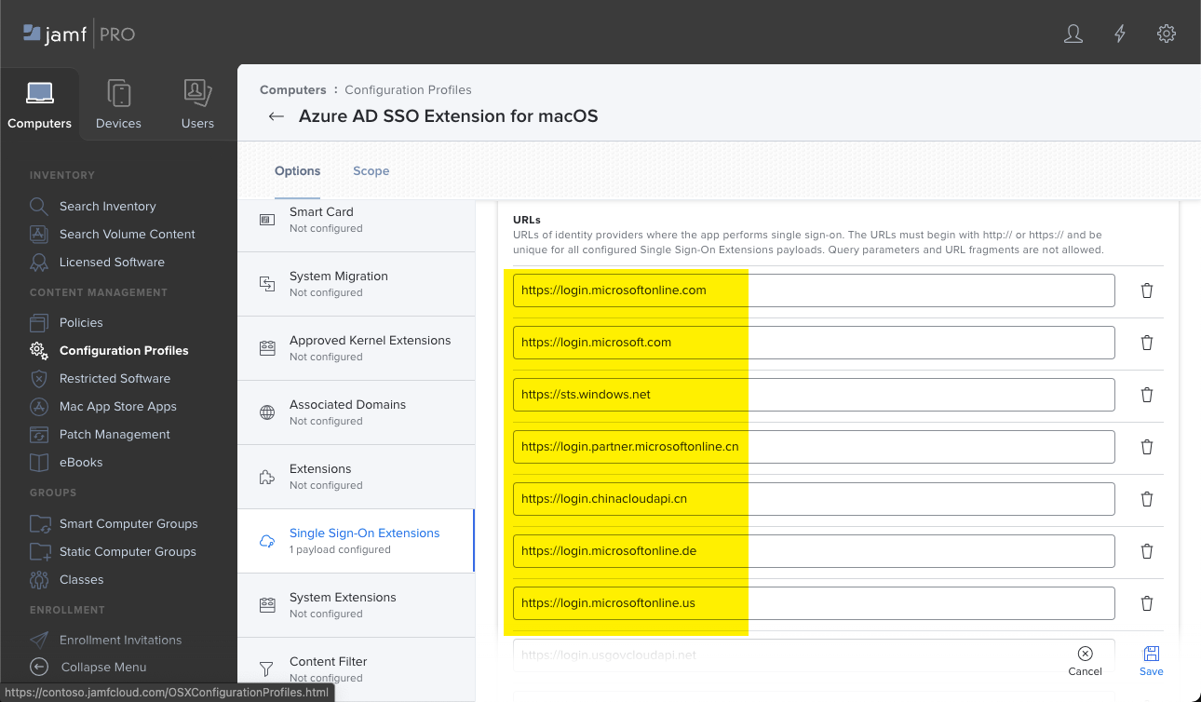
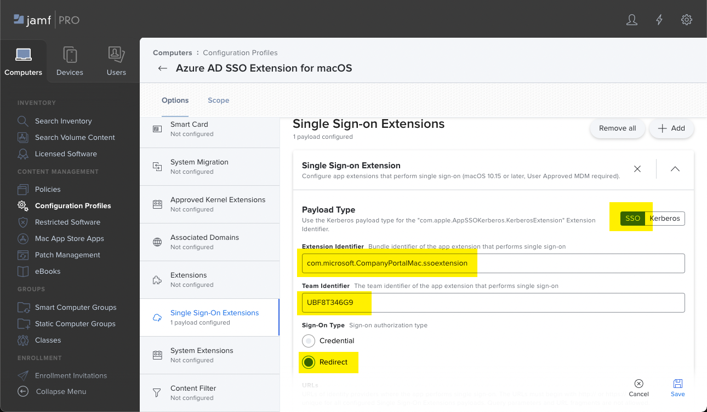
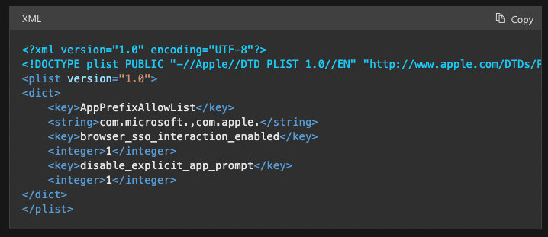
Recommendation 3: SSO – Modernize w/ IDP Vendor SSO Extensions
Redirect SSO Extension Profiles must be deployed via MDM:
Very easy deployment with Intune as your MDM
Jamf Pro requires a little more work and a PLIST file
https://aka.ms/AppleSSO-JamfPro

Slide 34
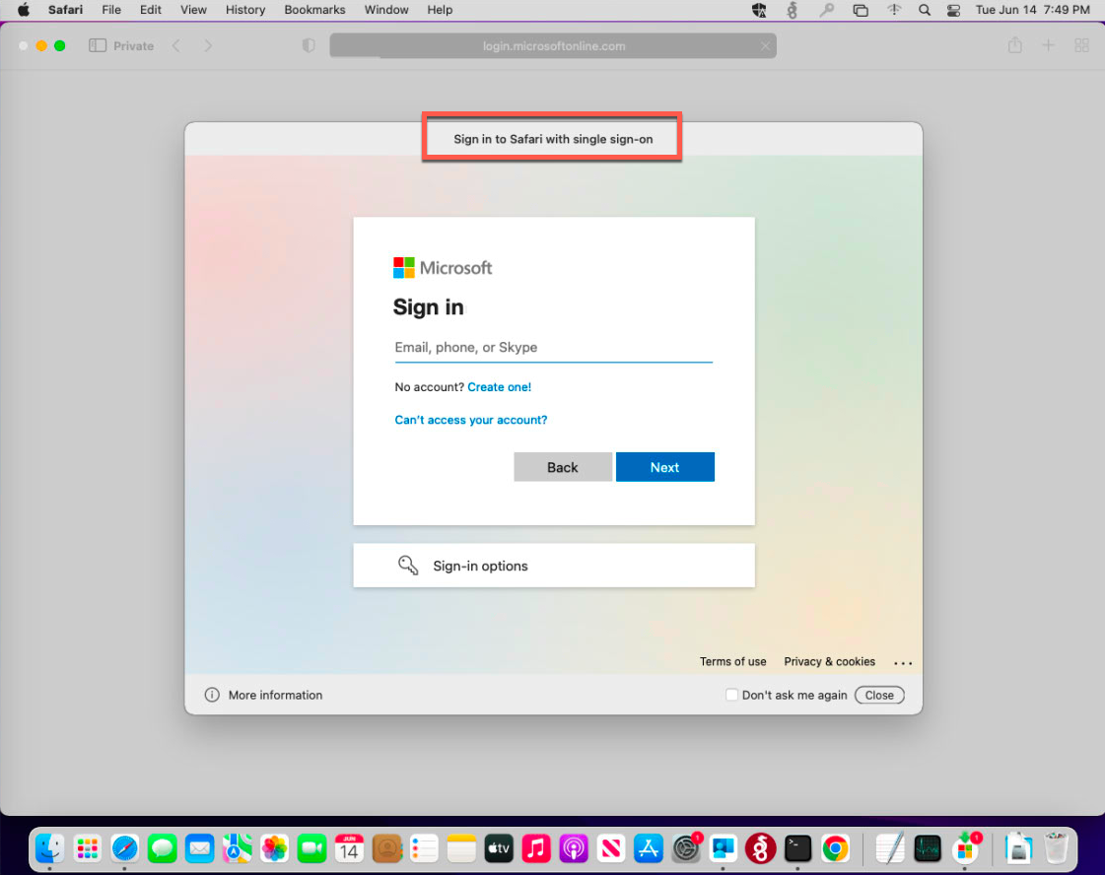
Recommendation 3: SSO – Modernize w/ IDP Vendor SSO Extensions
Redirect SSO Extension Profiles must be deployed via MDM:
Very easy deployment with Intune as your MDM
Jamf Pro requires a little more work and a PLIST file
Can configure settings so users never need to open Company Portal
Company Portal must always be installed, but users don’t need to open it if you follow recommended config
Don’t need to integrate with Intune for CA in order to get SSO, its just recommended
Easiest tool to test if things are working is Safari in Private mode

Slide 35
Recommendation 3: SSO – Modernize w/ IDP Vendor SSO Extensions
There’s a few limitations/caveats/warnings:
SSO Extension component from Microsoft is still Public Preview (supported)
Apps must use MSAL or Apple’s system frameworks for network requests
This means that some apps don’t work…the SSO Extension is unaware of them and they don’t use Apple’s network stack
Chrome and Firefox are the primary examples
Talk to your app vendors about the need to support SSO extensions! They should want their apps to work, Apple is only making SSO extensions more important as time goes on
PLIST files for non-Intune MDMs are hard to manage – we may change the extension default settings to be more mistake-friendly around GA timeframe
No support for FIDO keys as a passwordless auth method in the SSO Extension window, as of macOS Monterey
Authenticator App Phone Sign-In passwordless mode works well
More on Passwordless next…

Slide 36
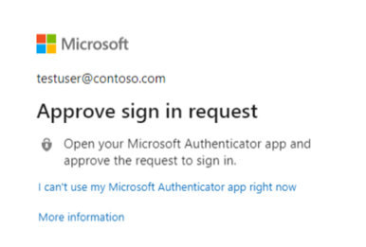
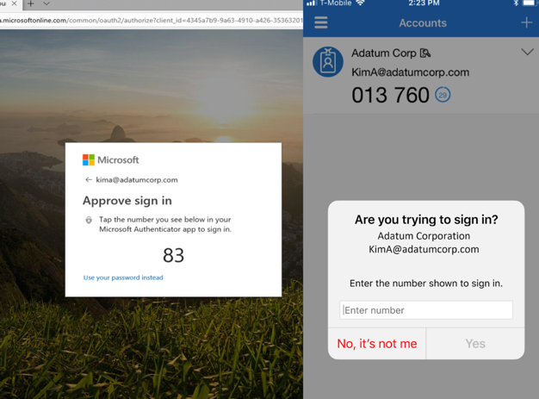
Recommendation 4: Authenticator App and Passwordless
Authenticator App used as a token broker for iOS devices (similar to Company Portal on MacOS)
Provides that PRT experience
https://aka.ms/nudge will interrupt on sign-in to register for Authenticator App
Move from push notification to number match if possible (MFA hammering)
Also used as a passwordless method

Slide 37
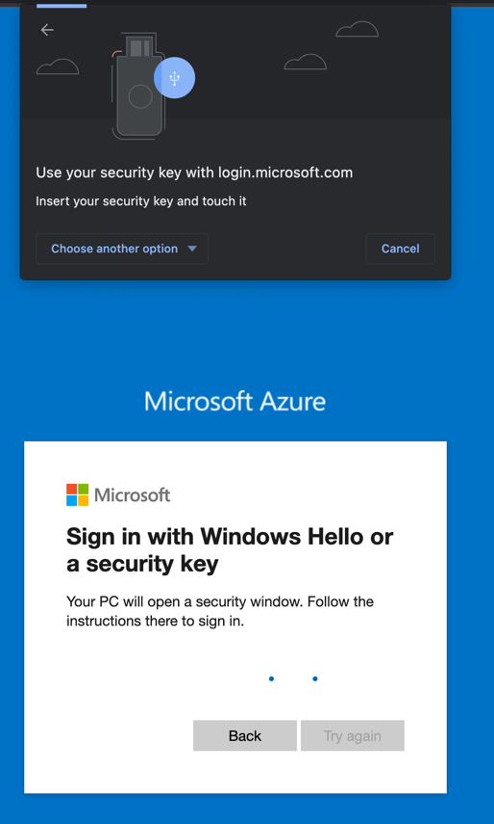
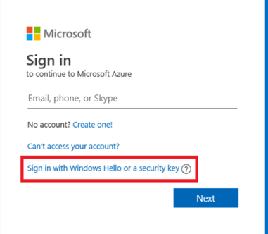
Recommendation 4: Authenticator App and Passwordless
Best user experience + Best security
We’ve been passwordless since Nov 2020 on macOS!
Can be used with any app integrated in your Azure AD
Passwordless methods
Authenticator app number match
FIDO2 Key
Private key never leaves the physical key
Edge and Chrome today
Safari in the future
Passkeys
Emerging standard supported by Apple, Microsoft and Google!
Passkey synced across devices on same device platform

Slide 38
Recommendation 5: SSO All the things!
All the work you do for steps 1-4 won’t matter much if your apps aren’t integrated with your IDP
Azure AD can publish many kinds of apps
Modern Auth (SAML, OAuth 2.0, OIDC)
On-premises legacy Kerberos
Password-based
Almost anything else via 3rd party integrations (F5, Akamai, etc.)
We try to make it easy for you…
Microsoft IT moved
17,987
3rd party apps from Microsoft’s internal ADFS to Azure Active Directory

Slide 39
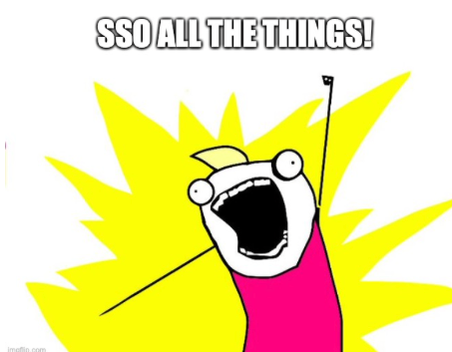
Recommendation 5: SSO All the things!
All the work you do for steps 1-4 won’t matter much if your apps aren’t integrated with your IDP
Azure AD can publish many kinds of apps
Modern Auth (SAML, OAuth 2.0, OIDC)
On-premises legacy Kerberos
Password-based
Almost anything else via 3rd party integrations (F5, Akamai, etc.)
We try to make it easy for you…

Slide 40





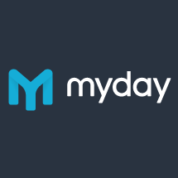



































Recommendation 5: SSO All the things! 3000+ pre-integrated apps in the gallery
Federated Connectors
Provisioning Connectors
3rd party native Azure AD apps
Sauce Labs – Mobile and Web testing | SkyHigh Networks | Jamf Pro
Skillport | Palo Alto Networks | Fidelity NetBenefits
OneTrust Privacy Management Software | Adobe Creative Cloud | Adobe Experience Manager
Apptio | Carlson Wagonlit Travel | DigiCert
SAP Cloud Platform Identity Authentication | Form.com | OrgChart Now
Cisco WebEx | Samanage
GitHub | LucidChart
BlueJeans | Zendesk
Tableau Online | ThousandEyes
Pingboard | Slack
Myday | Canvas | Calendly | Templafy
Doodle AG | Smartsheet | Nine for Office365 | K2 for Office365
Exclaimer Cloud | Firefly | Insights | Cronofy
Flipgrid | Edmodo | Boomerang | Bluemail
…and more added each month
Request a gallery app: https://aka.ms/AADAppGalleryRequest

Slide 41
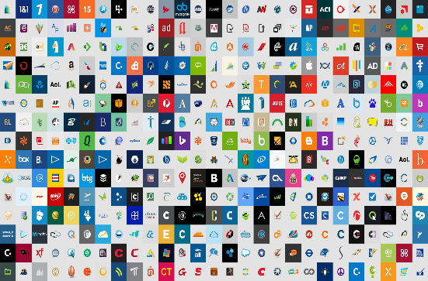






Recommendation 5: SSO All the things! Moving your on-premises apps to Azure AD
Cloud SaaS apps
Microsoft IT moved
Office 365
17,987
Azure Active Directory
3rd party apps from Microsoft’s internal ADFS to Azure Active Directory
Active Directory
and ADFS/Other
On-premises apps

Slide 42


Recommendation 5: SSO All the things! Application Proxy
https://appX-contoso.msappproxy.net/
Connect any claims-aware on-premises web app to Azure AD
Also, connect on-premises Kerberos apps to Azure AD
The goal is to get everything to use SSO
Azure Active Directory
Azure or 3rd Party IaaS
Application
Proxy
connector
DMZ
connector
connector
connector
app
app
app
app
VPN
On-premises apps

Slide 43



















Recommendation 5: SSO All the things!
Azure AD Connect
B2B collaboration
Provisioning-Deprovisioning
Conditional Access
SSO to SaaS
Self-Service capabilities
Connect Health
Multi-Factor Authentication
There’s a lot in Azure AD beyond SSO and Office 365
New features are released all the time, the cloud continues to evolve
Migrating apps to Azure AD means that they benefit from these features, and more
Provision/Deprovision to app based on dynamic group membership
Access Reviews/Entitlement Management/Governance tools
Same strong auth usage as other corporate apps
Addition of custom cloud apps
Access Panel/MyApps
Dynamic Groups
Identity Protection
Remote Access to on-premises apps
Azure AD B2C
Group-Based Licensing
Privileged Identity Management
Microsoft Authenticator - Password-less Access
Azure AD Join
MDM-auto enrollment /
Enterprise State Roaming
Security Reporting
Azure AD DS
Office 365 App Launcher
HR App Integration
Access Reviews

Slide 44
Agenda
What is Azure AD and Conditional Access?
Prompting…why is it bad?
Top 5 Recommendations
Go-Dos

Slide 45
Recap & Go Dos!
Work with your IAM/Security team on the end user experience
Use data in the Azure AD Authentication Prompt analysis (http://aka.ms/MFAPromptsWorkbook)
Set device compliance via Intune or an MDM
Deploy the Azure AD Enterprise SSO plugin to macOS and iOS
Nudge users to use the Microsoft Authenticator app on iOS/Android and start moving to passwordless
More SSO! Bring your modern auth apps to your IAM team. Move away from apps that require line of sight to a DC

Slide 46
Thank You
Slides: aka.ms/AADMacAdmins2022

